Slide 1

A Gentle Introduction to SDN
Y. Richard Yang
Yale/Tongji
Dec. 4, 2015

Slide 2
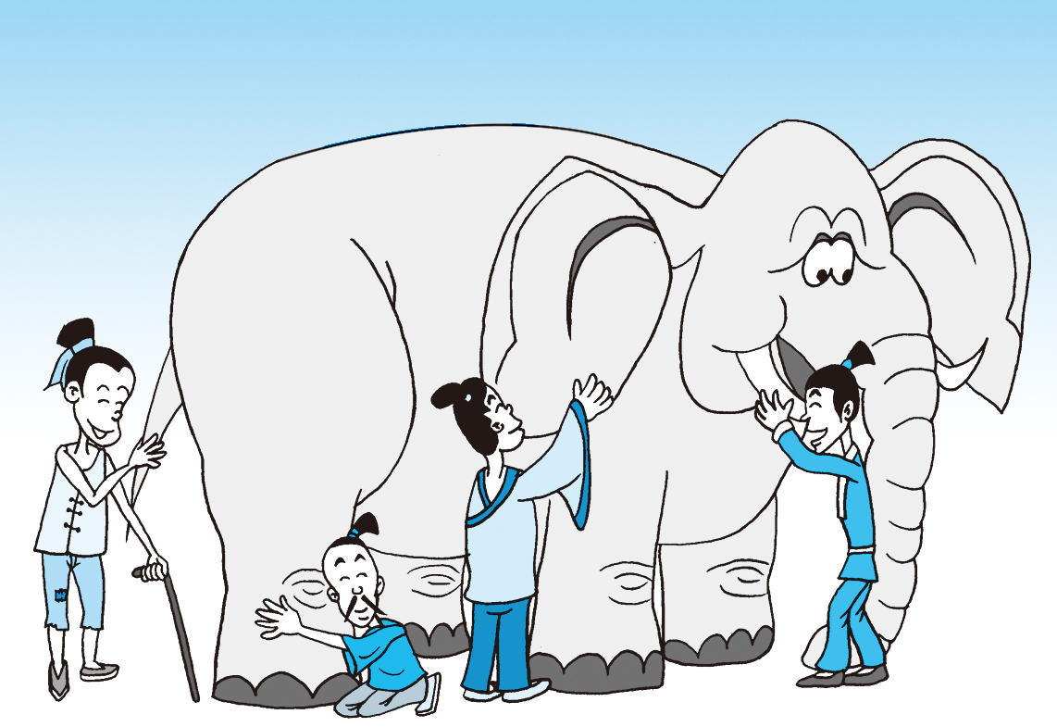
What is Software Defined Networking (SDN)?
Notes:
At a high level, abstraction is to hide issues that others do not want to or hard to do things.

Slide 3
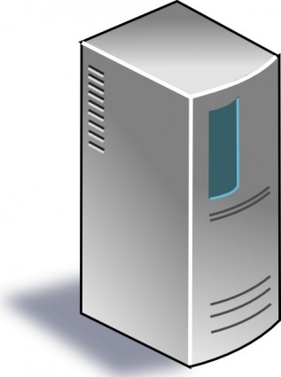
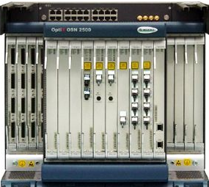
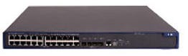
What is SDN: a “Main-Stream” View
Separation of data and control paths, with a logically centralized control plan
Traditional
SDN
Control
Control
standard control
protocol
Datapath
Datapath
Control
Datapath
Datapath
Control
Datapath
Datapath
Notes:
FLP, Arrow’s Impossibility Theorem. Failure of distributed computing.

Slide 4
An Evolution View of Intradomain Routing Toward SDN
Link State
Distance Vector
SDN
Control
Logically Central Link State
notification/
management/ control
protocol
Dijkstra
Distributed Bellman Ford
Distributed Link State
Dijkstra
Datapath
Distributed Bellman Ford
Distributed Link State
Dijkstra
Datapath
Distributed Bellman Ford
Distributed Link State
Datapath
Notes:
RIP: 1988 RFC1058 OSFPv2: RFC2328

Slide 5
Why SDN (A “Wiseman” View)?
Distributed computing is hard, e.g.,
FLP Impossibility Theorem
Arrow’s Impossibility Theorem
Achieved good design for only few specific tasks (e.g., state distribution, leader election). Hence, one can consider SDN as a way of moving away from generic distributed computing, by focusing on utilizing the few well-understood primitives, in particular logically centralized state.

Slide 6
What is SDN: a “Whitebox”/Programmable-Network View
Separation of switch hardware and software, or at least more programmable software on hardware.
Traditional
Whitebox
SoftwareB
SoftwareC
HardwareB
HardwareB
SoftwareA
SoftwareC
HardwareA
HardwareA
SoftwareC
SoftwareD
HardwareC
HardwareA

Slide 7
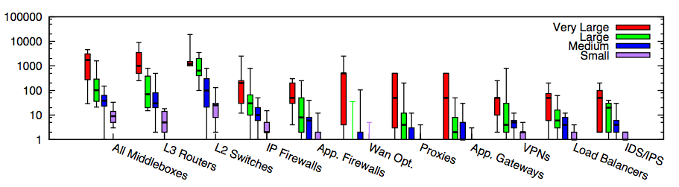
Why SDN or More Programmable Networks?
Modern networks contain diverse types of equipment from multiple vendors
In traditional settings, each type/vendor runs in its own hardware box, with its own software
More programmable (new app, new VM, new net OS, open source…) => More flexibility, lower TCO
Small: <=1k hosts; Medium: 1k-10k; Large: 10k-100k; Very Large: >= 100k
Source: [Sherry, et. al SIGCOMM’12]
Notes:
为啥呢？因为total ownership cost少。1. 我server买了，3年合同以后可以自行切换。前三年load cisco的virtual router，后三年load juniper的virtual switch。再过三年load palo alto的virutal firewall 2. 设备performance更新，只需要换低层硬件，就可以扩展
Router, switch, firewall merge
Server + software, which include Router, Switch, FT
DC -> Cloud
ENT switch reducing; Cloud increasing
There are more virtual ports than physical ports, where the virtual ports are controlled by x86 software. Where software erodes hardware

Slide 8
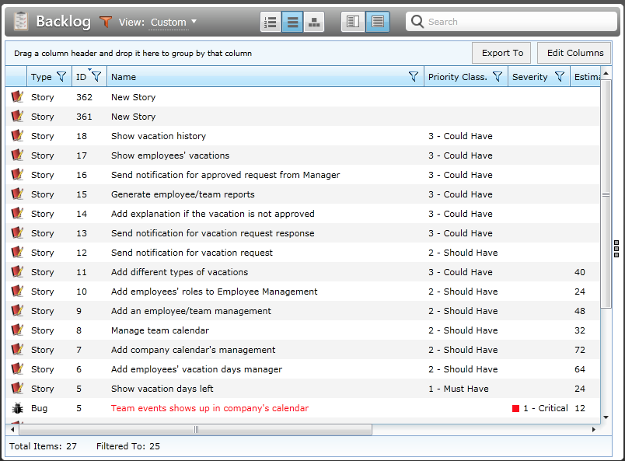
Why SDN or More Programmable Networks?
Network customization/feature requests can be a slow process. Open/programmable systems can speedup the process and allow more innovations.

Slide 9
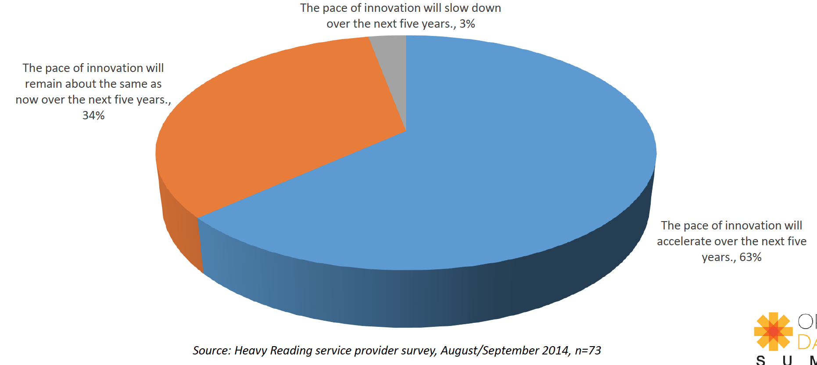
Service Provider Expectation on Pace Innovation
Notes:
“The cost to operate networks is too high and growing too fast and you can’t find enough people to manage these things anymore. It’s time for change.” -- Nick Lippis, ONUG /Fidelity, 2013
To appeal to companies looking for more highly customized systems, Cisco has also opened up its software to programmers in new ways, making it easier for clients to write their own apps for Cisco products.
http://www.bloomberg.com/news/articles/2015-11-05/cisco-s-new-ceo-embraces-the-cloud

Slide 10

More Programmable Networks are a Well Recognized Trend
“We are focusing on a market transition involving the move toward more programmable, flexible, and virtual networks… This transition is focused on moving from a hardware-centric approach for networking to a virtualized network environment that is designed to enable flexible, application-driven customization of network infrastructures. -- Cisco Annual Report (pp2), Nov. 2015
Notes:
“The cost to operate networks is too high and growing too fast and you can’t find enough people to manage these things anymore. It’s time for change.” -- Nick Lippis, ONUG /Fidelity, 2013
To appeal to companies looking for more highly customized systems, Cisco has also opened up its software to programmers in new ways, making it easier for clients to write their own apps for Cisco products.
http://www.bloomberg.com/news/articles/2015-11-05/cisco-s-new-ceo-embraces-the-cloud

Slide 11
What is SDN: A New Control-Plane Abstractions View
“Modularity based on abstraction is the way things get done.” -- Barbara Liskov
Major advances in many fields of computer science are based on simple, elegant, powerful abstractions
A major lacking of networking is that we do not have enough good abstractions in network control plane
Three key areas for abstractions [Shenker’11]: forwarding, distribution, configuration
Notes:
Hide details; Provide automatic optimization
Theory: Turing machine; systems: DB/relational algebra; OS/Virtual memory/thread; PL: low level language to higher level languages. Networking layer architecture is abstractions for data plane. Major advance is possible if we introduce the right abstractions in the network control plane.

Slide 12

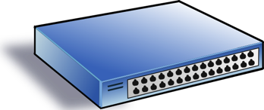
Major Areas of Control-Plane Abstraction
Service/ Policy
Program Logic
Datapath Model
Datapath Model
Network State

Slide 13
Outline
What is and why SDN?
SDN development
Notes:
At a high level, abstraction is to hide issues that others do not want to or hard to do things.

Slide 14
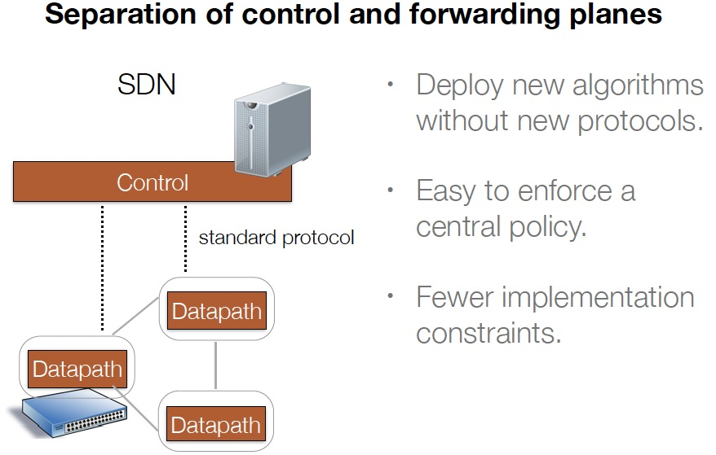
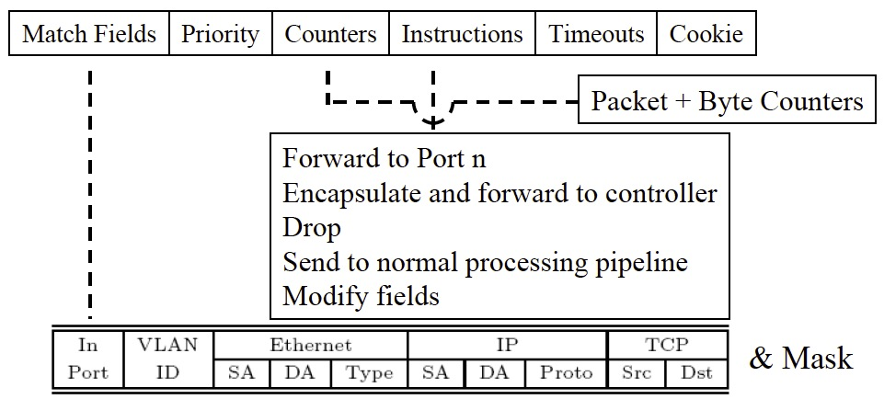
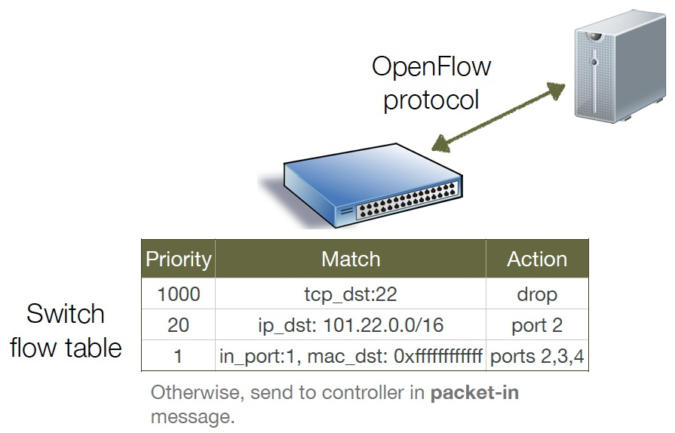
A Major SDN Milestone: OpenFlow

Slide 15
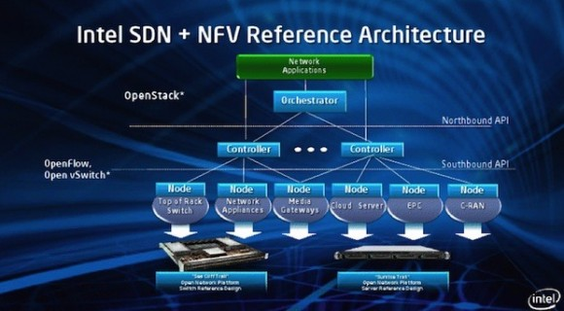
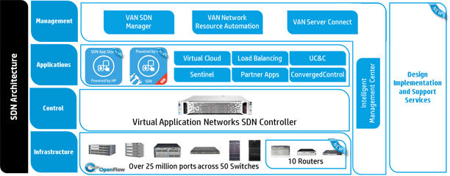
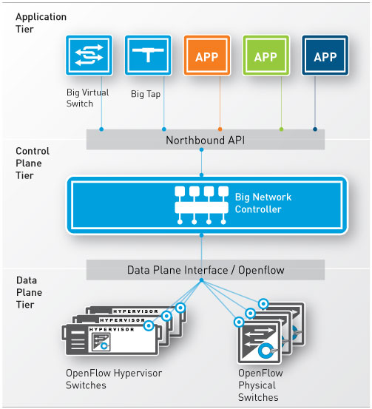
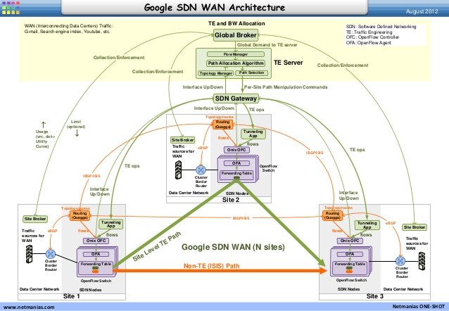
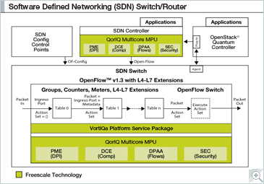
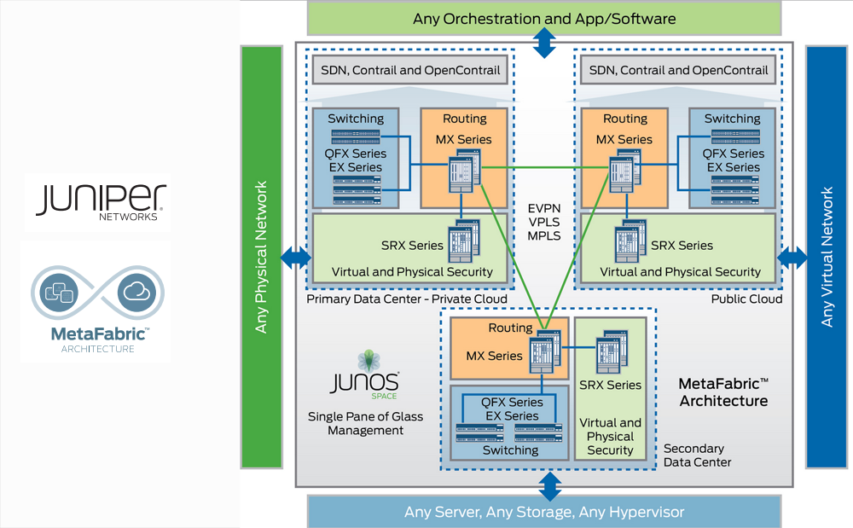
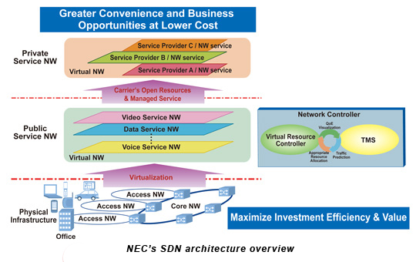
Almost Every Network Vendor has an SDN Architecture
http://h17007.www1.hp.com/images/networking/solutions/technology/sdn/sdn-architecture.jpg
Notes:
At a high level, abstraction is to hide issues that others do not want to or hard to do things.

Slide 16
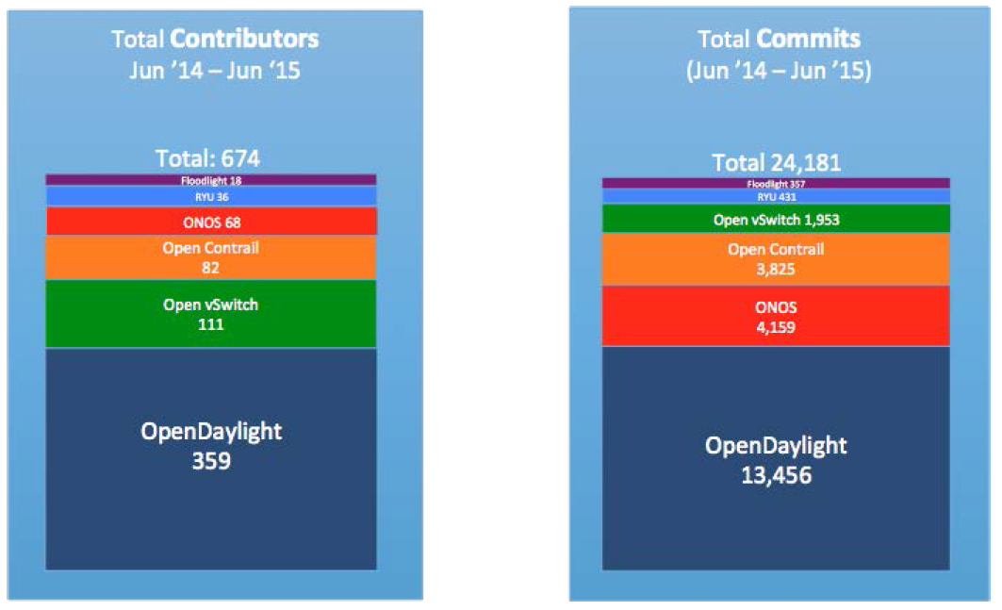
Multiple Open Source Communities
Source: Neela Jacques, July 2015.

Slide 17
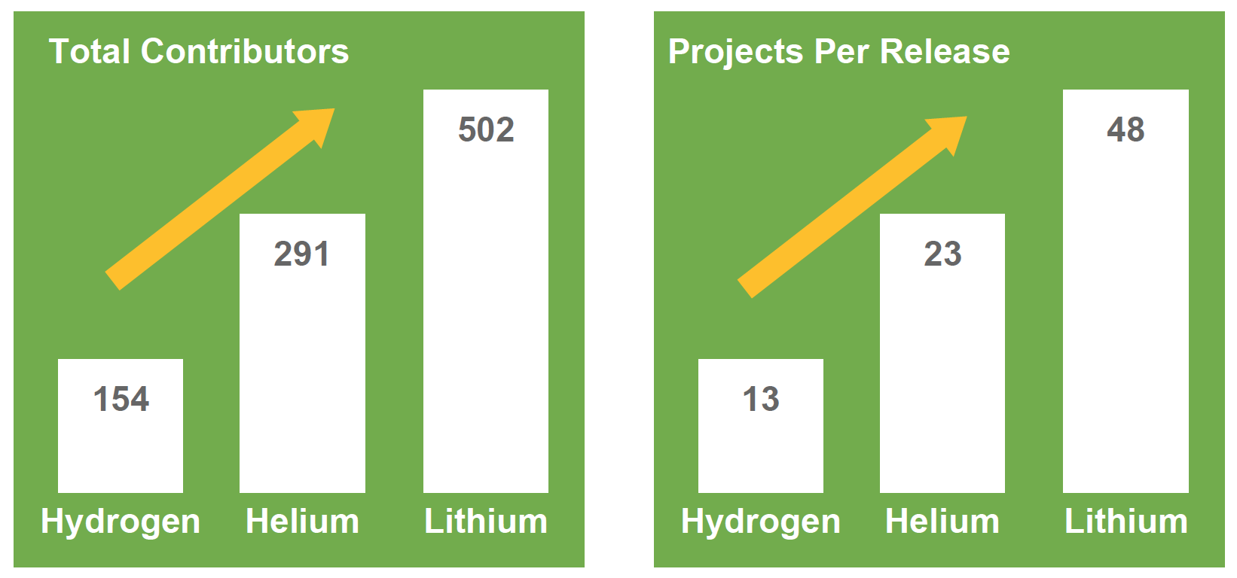
Increasing Interests (ODL as an Example)
Source: Neela Jacques, July 2015.
Notes:
At a high level, abstraction is to hide issues that others do not want to or hard to do things.

Slide 18
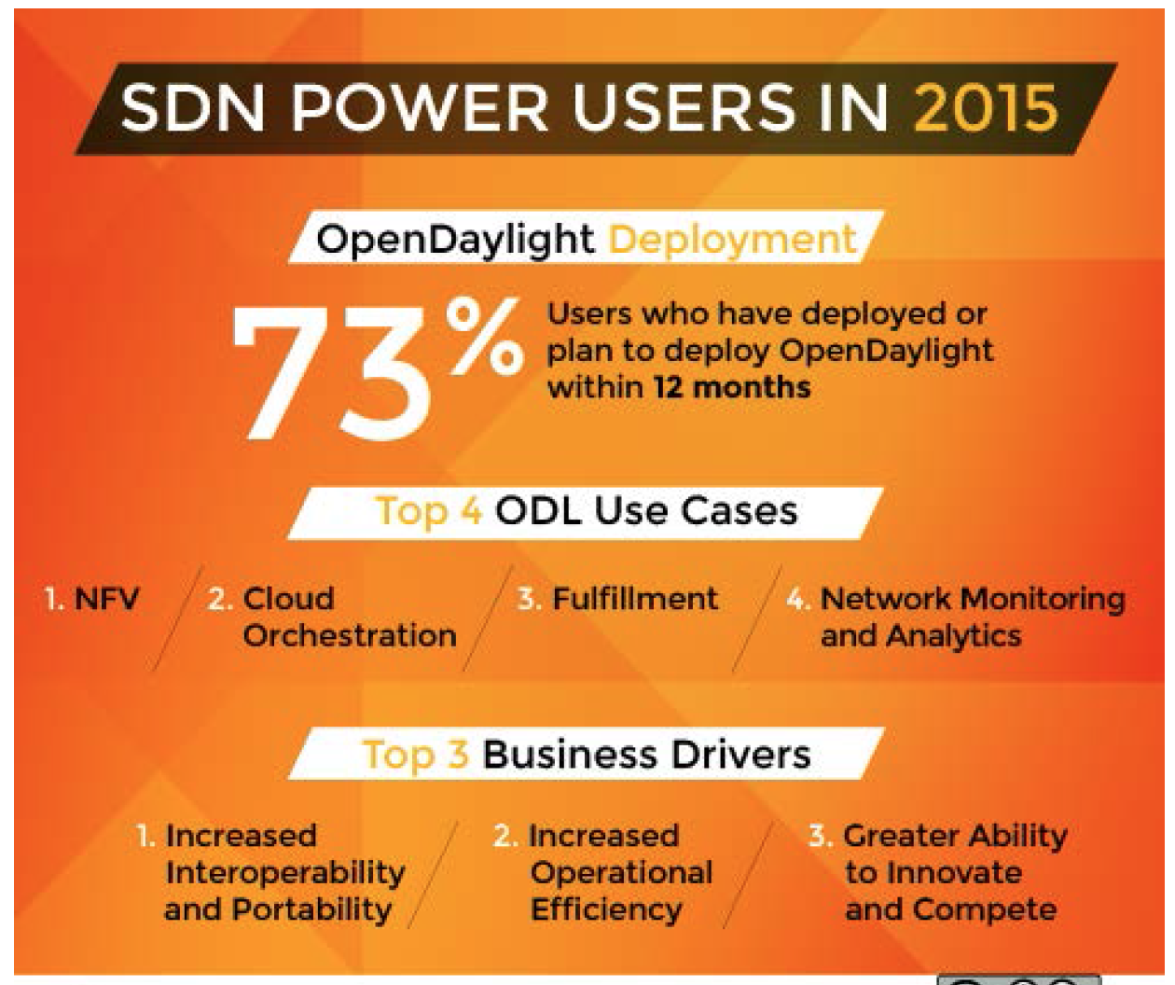
Usage of SDN
128 Companies responded
31% Telcos/Service Providers
24% Research/Academia
20% Enterprises
10% Services/Consulting
9% Software/Hardware
6% Other
Source: Neela Jacques, July 2015.
Notes:
At a high level, abstraction is to hide issues that others do not want to or hard to do things.

Slide 19
Outline
What is and why SDN?
SDN development
Overview of key SDN technical aspects
Architecture
Notes:
At a high level, abstraction is to hide issues that others do not want to or hard to do things.

Slide 20
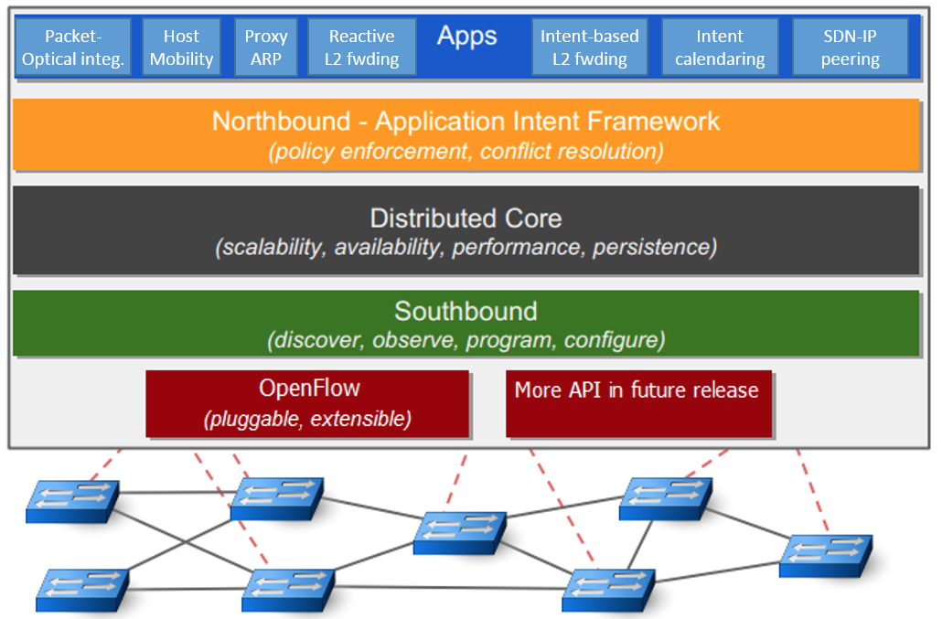
ONOS Architecture: Big Picture
Source: ON.LAB
Notes:
http://api.onosproject.org/1.1.0/org/onosproject/store/Store.html DeviceStore, HostStore, LinkStore, TopologyStore collect info from below
FlowRuleStore supports forwarding abstractions
IntentStore

Slide 21
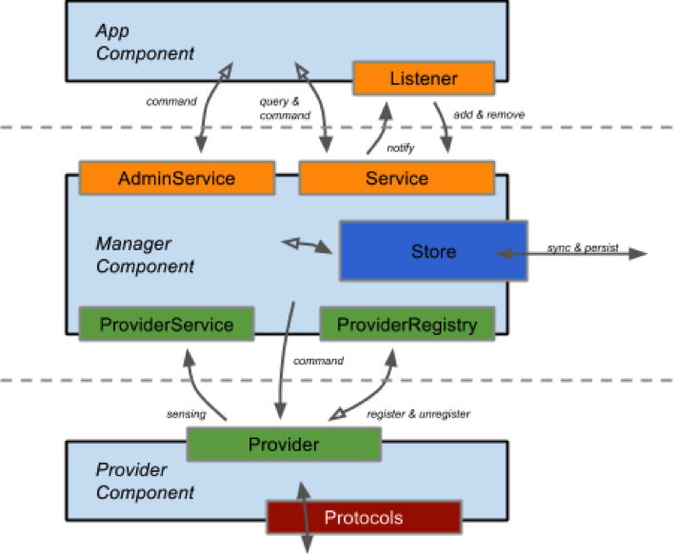
ONOS Architecture: Some Key Abstractions
https://wiki.onosproject.org/display/ONOS/System+Components
Notes:
http://api.onosproject.org/1.1.0/org/onosproject/store/Store.html DeviceStore, HostStore, LinkStore, TopologyStore collect info from below
FlowRuleStore supports forwarding abstractions
IntentStore

Slide 22
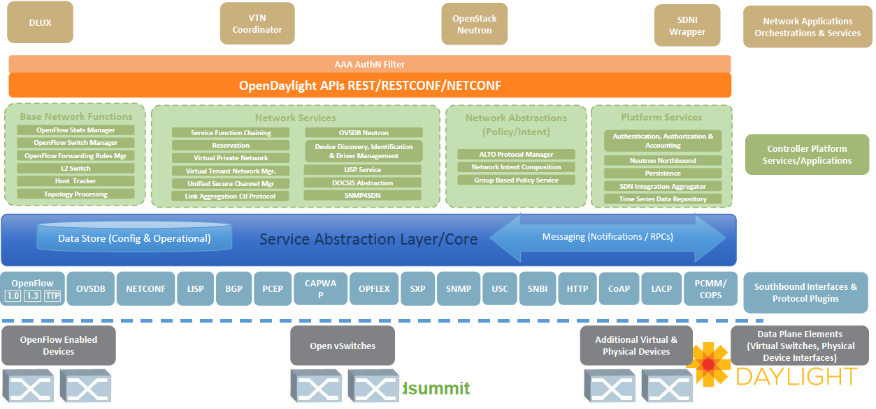
OpenDaylight Architecture: Big Picture
Source: Neela Jacques, July 2015.
Notes:
http://www.bigdatalandscape.com/

Slide 23
OpenDaylight: Some Key Abstractions
Network Devices
Applications
Network Applications Orchestration & Services
Network Devices
Applications
Network Devices
Applications
Controller
NETCONF SERVER
Protocol Plugin
...
Protocol Plugin
App/Service Plugin
...
App/Service Plugin
RESTCONF
Plugins & Applications
Config Subsystem
Model-Driven SAL (MD-SAL)
Controller Platform
Messaging
Data Store
Clustering
Remote Controller Instance
Remote Controller Instance
Source: Ed Warnicke, July 27, 2015.
23

Slide 24
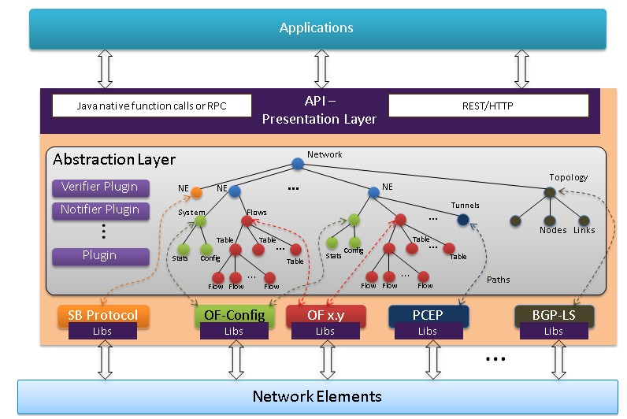
OpenDaylight: YANG Data Store
https://wiki.opendaylight.org/view/OpenDaylight_Controller:Architectural_Framework

Slide 25
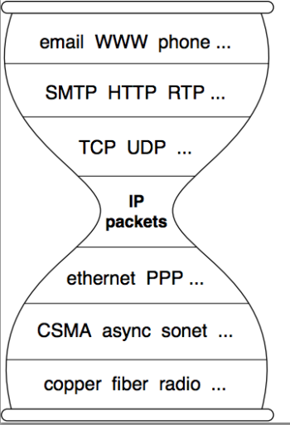
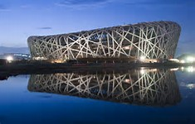
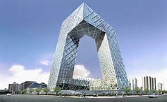
Questions to Keep in Mind in ADL on Architecture
- Q-Arch1: What are the commonality and differences among the SDN architectures?
- Q-Arch2: Is it possible that there can be a reference architecture?
Notes:
topology

Slide 26
Outline
What is and why SDN?
SDN now
Overview of key SDN technical aspects
Architecture
Datapath
Notes:
At a high level, abstraction is to hide issues that others do not want to or hard to do things.

Slide 27
Current SDN Data Path Designs
SDN
Control
OpenFlow
NetConf RestConf
SNMP
Forces
…
Datapath
Datapath
Datapath
OpenFlow1.x OFDPA P4 POF
…
Notes:
FLP, Arrow’s Impossibility Theorem. Failure of distributed computing.

Slide 28

Key Datapath Question
Q-Datapath: What should be the data path of network devices?
flow tables
VM/container

Slide 29
y = MAC % k has no Compact Flow Table Representation
Prove by contradiction.
Assume it has a flow table representation with less than 2⁴⁸ entries.
There is one flow rule with at least one wildcard bit
Make all but one * bits 0. Assume the only * bit is the t-th bit. Assume MAC is m when the t-th bit is 0.
=> m % k = (m+2^{t}) % k
p.ethSrc | Action
0000000 | y=0
...
1010*00010*000 | y=val
…

Slide 30
Outline
What is and why SDN?
SDN now
Overview of key SDN technical aspects
Architecture
Datapath
Programming abstractions and framework
Notes:
At a high level, abstraction is to hide issues that others do not want to or hard to do things.

Slide 31
Complexity of a Network Decision Process
Map<MAC, Location> hostTable; List<ACLItem> acls;
….
hostTable.put(p.ethSrc(), p.ingressPort());
if ( !permit(p, acls) ) return drop;
Location src = p.ingressPort();
Location dst = hostTable.get( p.ethDst() );
Route path = myRoutingAlg(topology(), src, dst);
return path;
…
Has physical states
Depends on physical states
External process may change the state
External process may change states
Depends on policy state
Data path may need to detect change and update state
May need complex computation
Decision depends on pkt attributes
Depends on pkt attributes

Slide 32
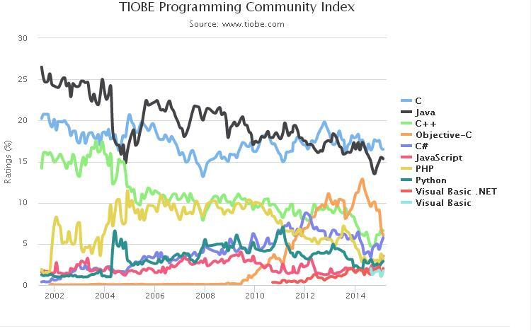
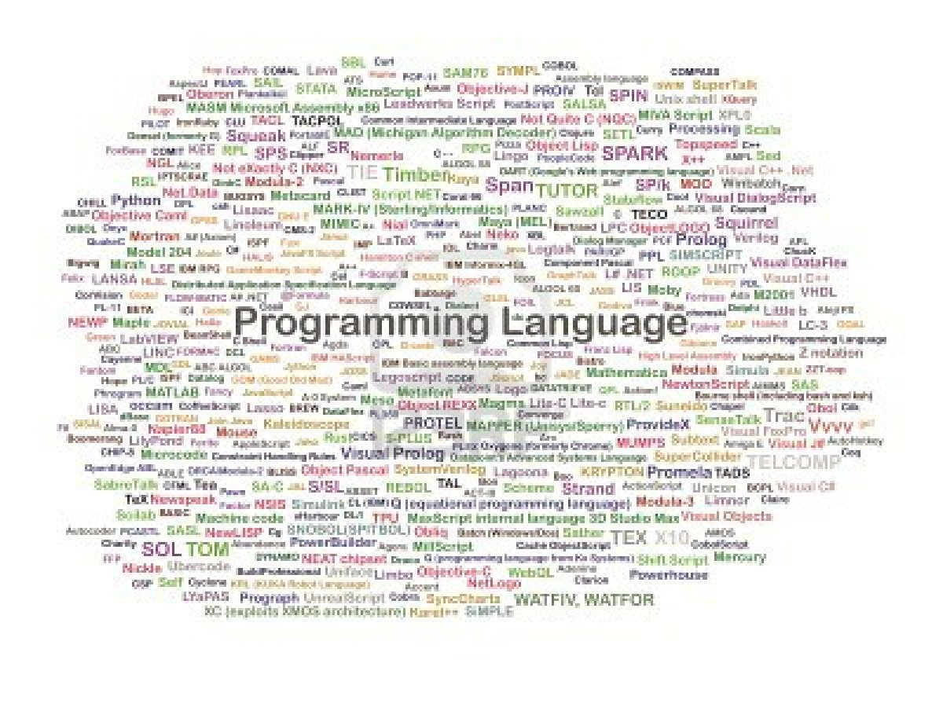
Question to Keep in Mind on SDN Programming
Q-Prog: What are the right programming abstractions and frameworks for SDN?
Source: http://www.freaksense.com/wp-content/uploads/2013/07/10580033-it-a-full-collection-of-programming-language.jpg
Notes:
topology

Slide 33
SDN vs Inherent Complexity
Conjecture [Meyer]: Complexity in highly organized systems arises primarily from design strategies intended to create robustness to uncertainty in their environments and component parts.
Scalability is robustness to changes to the size and complexity of a system as a whole.
Evolvability is robustness of lineages to large changes on various (usually long) time scales.
Reliability is robustness to component failures.
Efficiency is robustness to resource scarcity.
Modularity is robustness to component rearrangements.
Q-Prog-Complexity: Can SDN programming solve (or at least reduce) inherent complexity?
Notes:
At a high level, abstraction is to hide issues that others do not want to or hard to do things.

Slide 34
Outline
What is and why SDN?
SDN now
SDN key technical components
Architecture
Datapath
Programming abstractions and framework
SDN killer apps
Notes:
At a high level, abstraction is to hide issues that others do not want to or hard to do things.

Slide 35
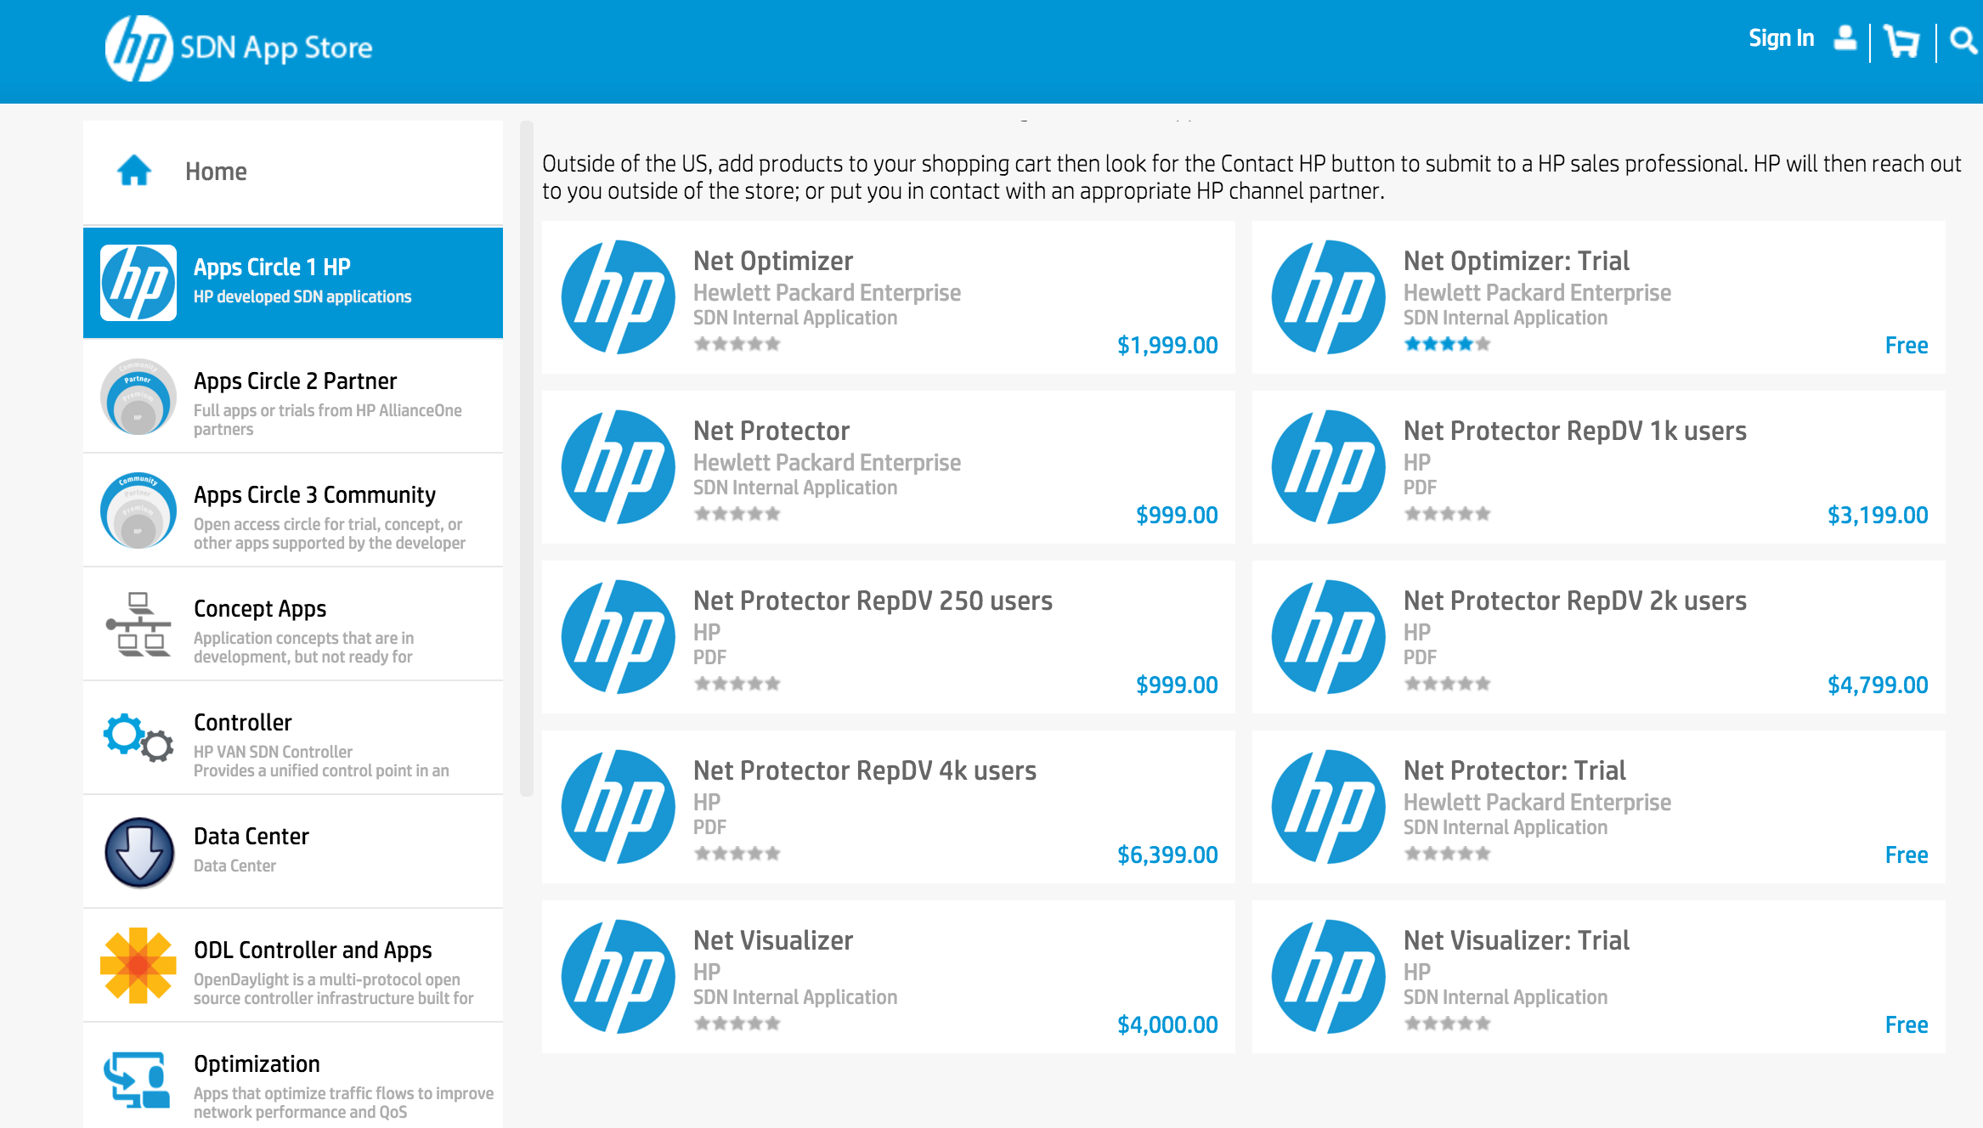

Questions to Keep in Mind on SDN Killer Apps
Q-app: What are the killer apps of SDN?
Source: http://api.ning.com/files/qgybvJa4VHgEUDHXfN3PUL4Bru*HAQP7gtHz5BUaG6YH*1As0tr9MGh8ewH34GQPpLsxPOh8iYgP3BRLEWSSClN274raRTRX/killer_apps_600x300.jpg
Notes:
topology

Slide 36
What may lead to fall of SDN?
Unstable, increasingly complex data path?
Fail to integrate key domains (e.g., wireline+wifi+cellular)?
No killer apps?
….
Notes:
topology

Slide 37
Thank you and enjoy the rest of ADL!
Notes:
At a high level, abstraction is to hide issues that others do not want to or hard to do things.

Slide 38
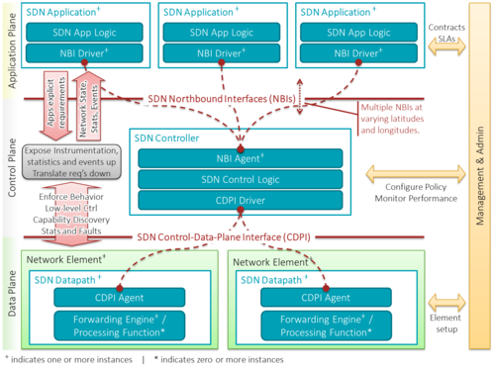
SDN Architecture (Wikipedia)
https://upload.wikimedia.org/wikipedia/commons/thumb/e/e6/SDN-architecture-overview-transparent.png/500px-SDN-architecture-overview-transparent.png
Notes:
topology

Slide 39
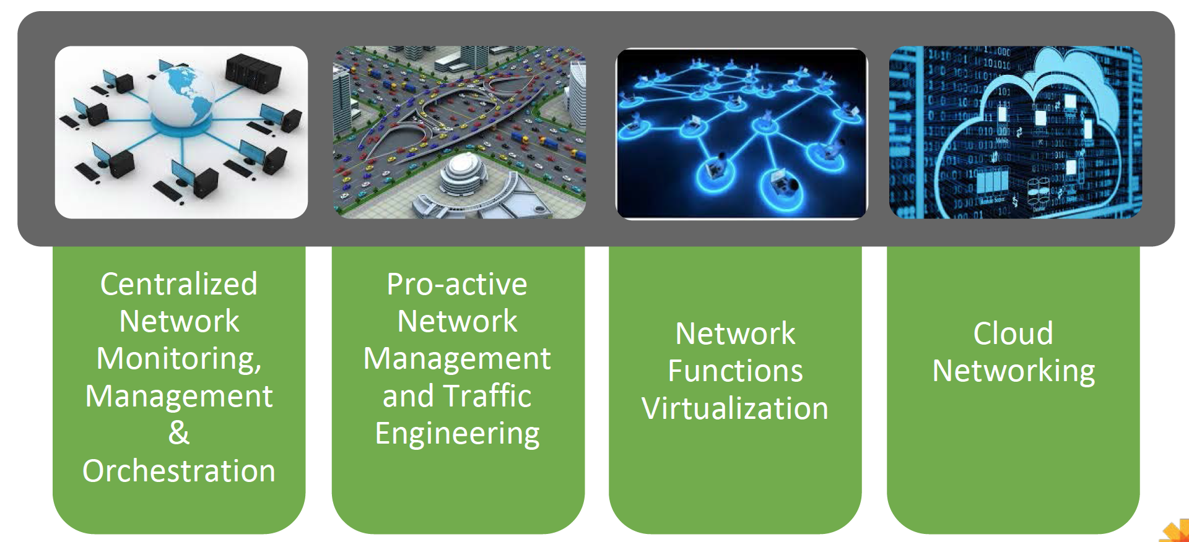
Some Main Current Use Cases of SDN
Source: Neela Jacques, July 2015.
Notes:
At a high level, abstraction is to hide issues that others do not want to or hard to do things.

